Slide 1
What We Did So Far
December 2018

Slide 2
Table of Contents
Monitoring Schemes
Monitored Functions
Value Scheme vs. Distance Scheme

Slide 3
Monitoring Schemes

Slide 4
Table of Contents
Vector Scheme
Value Scheme
Distance Scheme
Sketched Data Resolution
Sketched Change Resolution

Slide 5
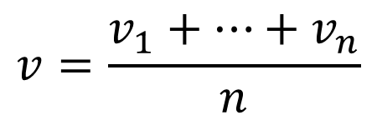

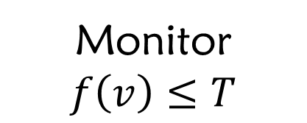
Reminder: Monitoring Objective
$$node_{i}←v_{i}$$
Convex f
$$v=\frac{v_{1}+…+v_{n}}{n}$$
Monitor
$$f\left(v\right)≤T$$

Slide 6
Vector Scheme

Slide 7
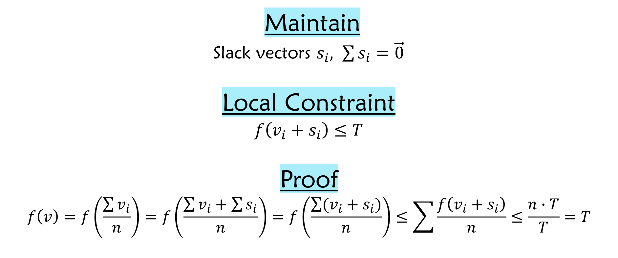
Vector Scheme
Maintain
Slack vectors $s_{i}, \sum{s_{i}}=\vec{0}$
Local Constraint
$$f\left(v_{i}+s_{i}\right)≤T$$
Proof
$$f\left(v\right)=f\left(\frac{\sum{v_{i}}}{n}\right)=f\left(\frac{\sum{v_{i}}+\sum{s_{i}}}{n}\right)=f\left(\frac{\sum{(v_{i}+s_{i})}}{n}\right)≤\sum{\frac{f\left(v_{i}+s_{i}\right)}{n}}≤\frac{n∙T}{T}=T$$

Slide 8
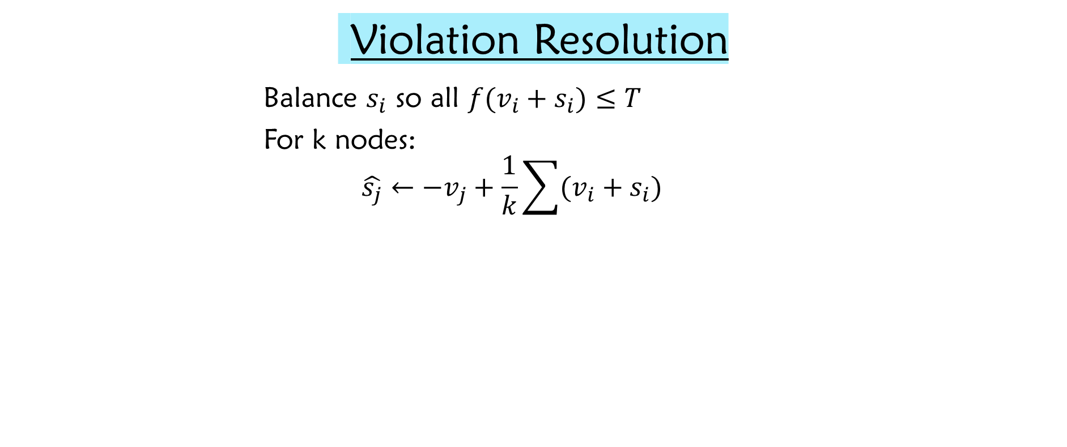
Vector Scheme
Violation Resolution
Balance $s_{i}$ so all $f(v_{i}+s_{i})≤T$
For k nodes:
$$\hat{s_{j}}←−v_{j}+\frac{1}{k}\sum{(v_{i}+s_{i})}$$

Slide 9
Distance Scheme

Slide 10
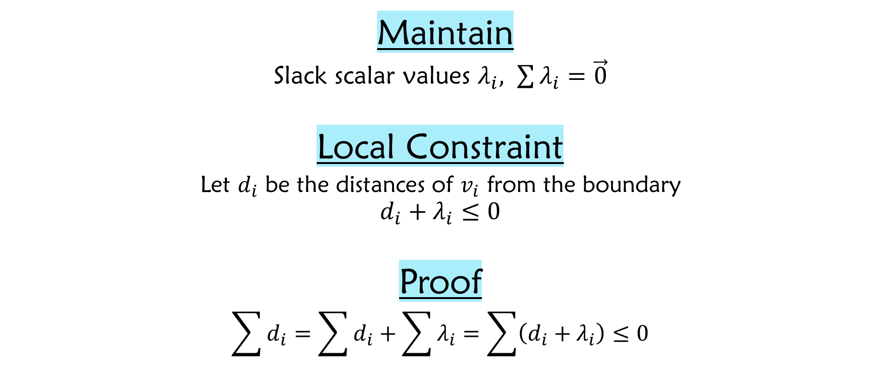
Distance Scheme
Maintain
Slack scalar values $λ_{i}, \sum{λ_{i}}=\vec{0}$
Local Constraint
$$\text{Let} d_{i} \text{be} \text{the} \text{distances} \text{of} v_{i} \text{from} \text{the} \text{boundary}$$
$$d_{i}+λ_{i}≤0$$
Proof
$$\sum{d_{i}}=\sum{d_{i}}+\sum{λ_{i}}=\sum{\left(d_{i}+λ_{i}\right)≤0}$$
Distance Lemma

Slide 11

Distance Scheme
Violation Resolution
Balance $λ_{i}$ so all $d_{i}+λ_{i}≤0$
For k nodes:
$$\hat{λ_{j}}←−d_{j}+\frac{1}{k}\sum{(d_{i}+λ_{i})}$$

Slide 12
Value Scheme

Slide 13
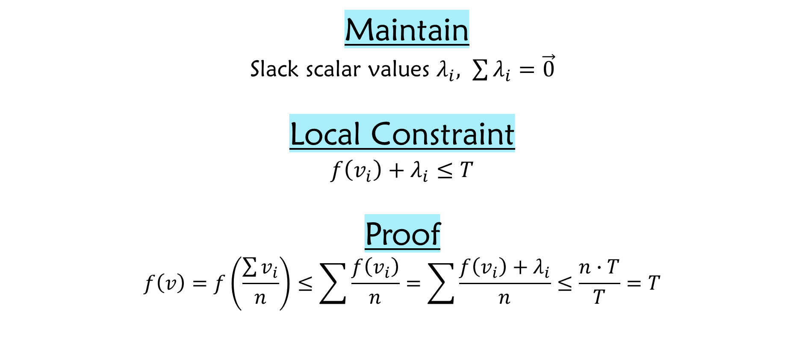
Value Scheme
Maintain
Slack scalar values $λ_{i}, \sum{λ_{i}}=\vec{0}$
Local Constraint
$$f\left(v_{i}\right)+λ_{i}≤T$$
Proof
$$f\left(v\right)=f\left(\frac{\sum{v_{i}}}{n}\right)≤\sum{\frac{f\left(v_{i}\right)}{n}}=\sum{\frac{f\left(v_{i}\right)+λ_{i}}{n}}≤\frac{n∙T}{T}=T$$

Slide 14

Value Scheme
Violation Resolution
Balance $λ_{i}$ so all $f\left(v_{i}\right)+λ_{i}≤T$
For k nodes:
$$\hat{λ_{j}}←−f\left(v_{j}\right)+\frac{1}{k}\sum{(f\left(v_{i}\right)+λ_{i})}$$

Slide 15
Sketched Data Resolution

Slide 16





Gradual Full Sync
Value Scheme
Fail
Success
$||$Sketch$||$ = 2
Fail
Success
$||$Sketch$||$ = 4
$$⋮$$
$$⋮$$
$||$Sketch$||$ = ^{n}/₂

Slide 17
Gradual Full Sync
Distance Scheme
Fail
Success
$||$Sketch$||$ = 2
Fail
Success
$||$Sketch$||$ = 4
$$⋮$$
$$⋮$$
$||$Sketch$||$ = ^{n}/₂

Slide 18
Some Intuition
Vector Scheme’s Resolution
‘Sketched’ Resolution

Slide 19
Some Intuition
Vector Scheme’s Resolution
‘Sketched’ Resolution

Slide 20
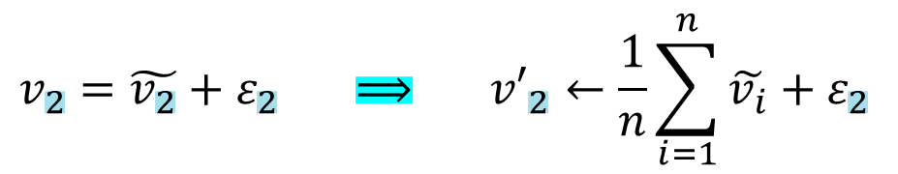

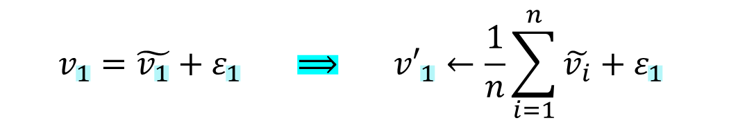





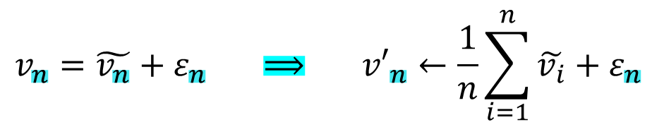
Sketched Data Resolution
Violation Resolution
$$v_{1}=\tilde{v_{1}}+ε_{1} ⟹ {v′}_{1}←\frac{1}{n}\sum_{i=1}^{n}{\tilde{v_{i}}}+ε_{1}$$
$$v_{2}=\tilde{v_{2}}+ε_{2} ⟹ {v′}_{2}←\frac{1}{n}\sum_{i=1}^{n}{\tilde{v_{i}}}+ε_{2}$$
Coordinator
$$\frac{1}{n}\sum_{i=1}^{n}{\tilde{v_{i}}}$$
$$\frac{1}{n}\sum_{i=1}^{n}{\tilde{v_{i}}}$$
$$⋮$$
$$v_{n}=\tilde{v_{n}}+ε_{n} ⟹ {v′}_{n}←\frac{1}{n}\sum_{i=1}^{n}{\tilde{v_{i}}}+ε_{n}$$
$$\tilde{v_{1}}$$
$$\tilde{v_{2}}$$
$$\tilde{v_{n}}$$
…

Slide 21
Sketched Change Resolution

Slide 22






Sketched Change Resolution
Violation Resolution
Recall, $v_{i}=ref+chng$
Perform sketch function on $chng$ vector
Instead of on $v_{i}$
Coordinator
$$\frac{1}{n}\sum_{i=1}^{n}{\tilde{{chng}_{i}}}$$
$$\frac{1}{n}\sum_{i=1}^{n}{\tilde{{chng}_{i}}}$$
$$\tilde{{chng}_{1}}$$
$$\tilde{{chng}_{2}}$$
$$\tilde{{chng}_{n}}$$
…

Slide 23
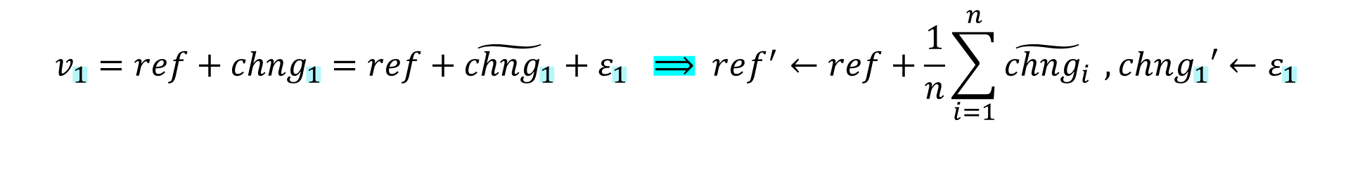

Sketched Change Resolution
Violation Resolution
$$v_{1}=ref+{chng}_{1}=ref+\tilde{{chng}_{1}}+ε_{1} ⟹ ref^{′}←ref+\frac{1}{n}\sum_{i=1}^{n}{\tilde{{chng}_{i}}} ,{chng}_{1}′←ε_{1}$$
$$v_{2}=ref+{chng}_{2}=ref+\tilde{{chng}_{2}}+ε_{2} ⟹ ref^{′}←ref+\frac{1}{n}\sum_{i=1}^{n}{\tilde{{chng}_{i}}} ,{chng}_{2}′←ε_{2}$$
$$⋮$$
$$v_{n}=ref+{chng}_{n}=ref+\tilde{{chng}_{n}}+ε_{n} ⟹ ref^{′}←ref+\frac{1}{n}\sum_{i=1}^{n}{\tilde{{chng}_{i}}} ,{chng}_{n}′←ε_{n}$$

Slide 24
Monitored Functions

Slide 25
Table of Contents
Inner Product
Entropy
Norm Squared
Spectral Gap
AMS F₂

Slide 26
Inner Product

Slide 27
Inner Product
f(x,y)=<x,y>=¹/₄($||$x+y$||$² - $||$x-y$||$²)
 | Bounding Convex Function | Distance to Convex Function
Upper Bound | Mathematical Solution | Mathematical Solution
Lower Bound | Mathematical Solution | Mathematical Solution

Slide 28
Entropy

Slide 29
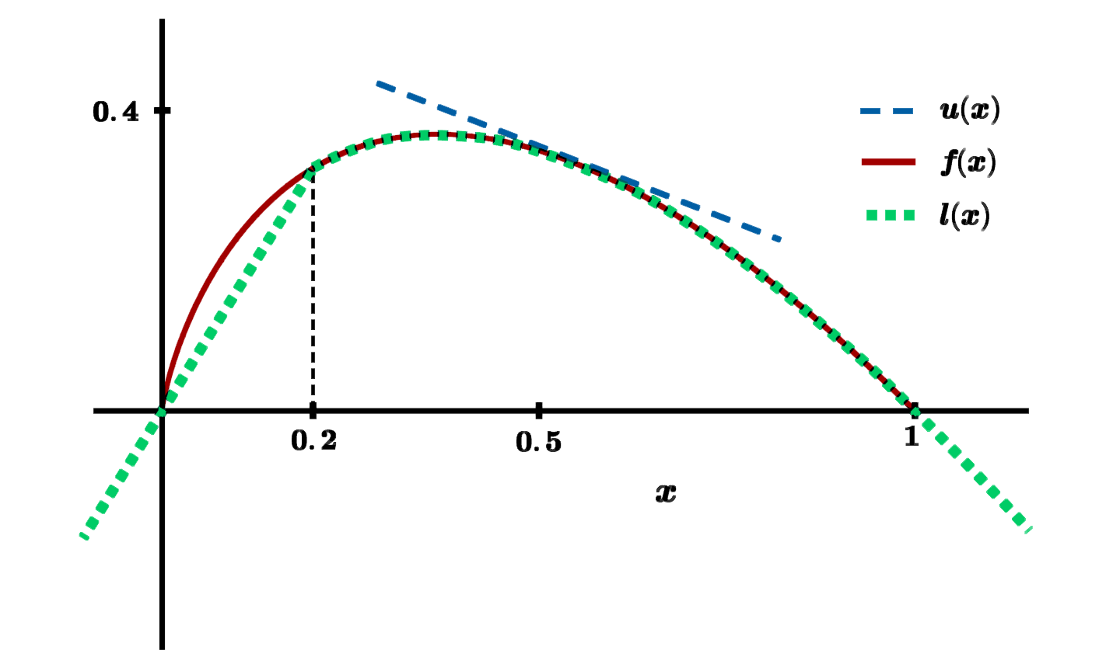
Entropy
f(x)=-$Σ$(x_{i}$∙$ln(x_{i}))

Slide 30
Entropy
f(x)=-$Σ$(x_{i}$∙$ln(x_{i}))
 | Bounding Convex Function | Distance to Convex Function
Upper Bound | Tangent Plane | Mathematical Solution
Lower Bound | Function Itself | Computational Method

Slide 31
Norm Squarred

Slide 32
Norm Squared
f(x)= $||$x$||$²
 | Bounding Convex Function | Distance to Convex Function
Upper Bound | Tangent Plane | Mathematical Solution
Lower Bound | Function Itself | Mathematical Solution

Slide 33
Spectral Gap

Slide 34
Spectral Gap
f(M)= $λ$₁(M)-$λ$₂(M)
 | Bounding Convex Function | Distance to Convex Function
Upper Bound | ??? | ???
Lower Bound | Mathematical Solution | Bound of Distance

Slide 35
AMS F₂

Slide 36
AMS F₂
f(M)= median of row averages of M$∙$M (pointwise mul)
 | Bounding Convex Function | Distance to Convex Function
Upper Bound | Mathematical Solution | Mathematical Solution
Lower Bound

Slide 37
Experimental Results

Slide 38
Inner Product

Slide 39
Bag-of-Words Textual Data Sources
Tweets from the end of 2009
Blogs textual data
Restaurant Reviews
Reddit comments from 2015
Spam click-baits new headlines
News pieces from India
Wikipedia article as of March 2017
Amazon reviews of movies
X
<X,Y>
Y

Slide 40
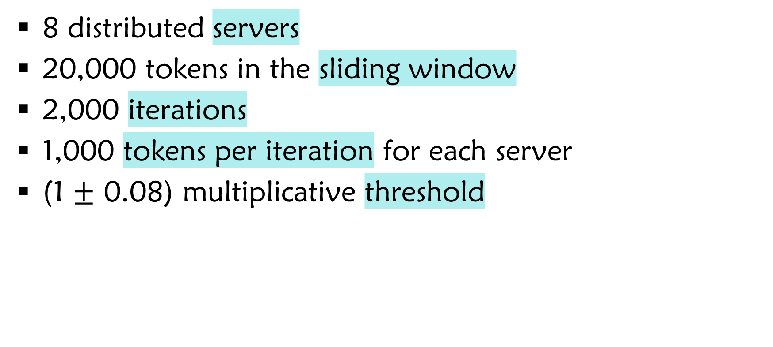
Parameters
8 distributed servers
20,000 tokens in the sliding window
2,000 iterations
1,000 tokens per iteration for each server
(1 $±$ 0.08) multiplicative threshold

Slide 41
Bandwidth
Bandwidth
|vector|

Slide 42
Bandwidth
Bandwidth
|vector|

Slide 43
Average Amount of Full Syncs Compared to Oracle
Full Syncs
Scheme

Slide 44
Entropy

Slide 45
Bag-of-Words Textual Data Sources
Tweets from the end of 2009
Blogs textual data
Restaurant Reviews
Reddit comments from 2015
Spam click-baits new headlines
News pieces from India
Wikipedia article as of March 2017
Amazon reviews of movies

Slide 46
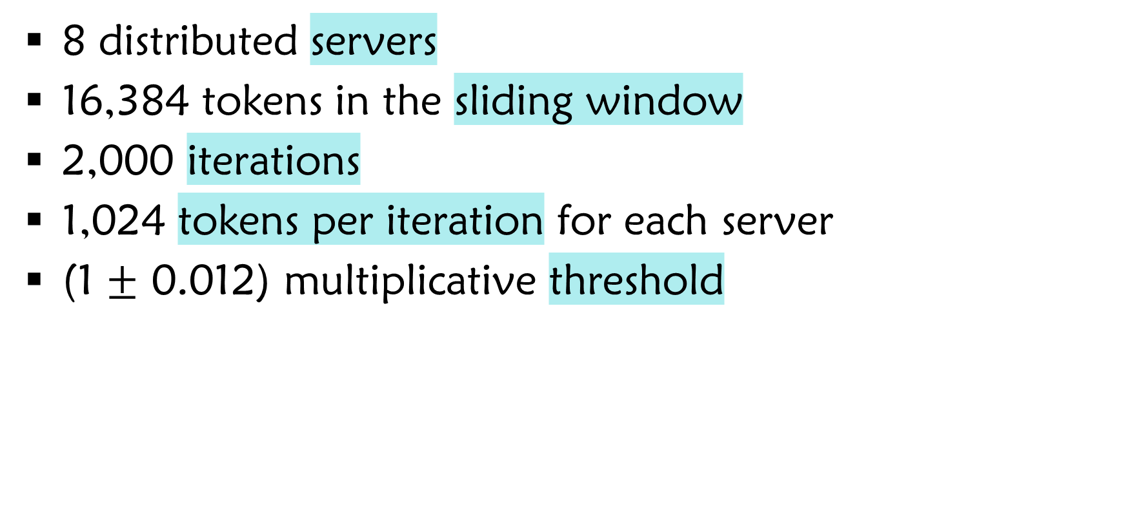
Parameters
8 distributed servers
16,384 tokens in the sliding window
2,000 iterations
1,024 tokens per iteration for each server
(1 $±$ 0.012) multiplicative threshold

Slide 47
Bandwidth
Bandwidth
|vector|

Slide 48
Bandwidth
Bandwidth
|vector|

Slide 49
Average Amount of Full Syncs Compared to Oracle
Full Syncs
Scheme

Slide 50
Spectral Gap

Slide 51
AMS F₂

Slide 52
Parameters
10 distributed servers
Synthetic randomized data
Constant threshold

Slide 53
One Server Changes -52x46 F₂ Sketch-
Bandwidth
Iteration

Slide 54
One Server Changes -Bandwidth-
Bandwidth
|vector|

Slide 55
One Server Changes -Bandwidth-
Bandwidth
|vector|

Slide 56
One Server Changes -Average Full Syncs-
Bandwidth
Scheme

Slide 57
All Server Change -52x46 F₂ Sketch-
Bandwidth
Iteration

Slide 58
All Servers Change -Bandwidth-
Bandwidth
|vector|

Slide 59
All Servers Change -Bandwidth-
Bandwidth
|vector|

Slide 60
All Server Change -Average Full Syncs-
Bandwidth
Scheme

Slide 61
Value vs Distance

